Slide 1
Classes and Objects in Processing Part 1
Having used Alice you will be aware of objects. Instances of Alice, the White Rabbit and T Rex are all objects. In fact we can have multiple objects of one type or class.
Today we are going to look at objects and classes in Processing. These are similar to Java objects and classes.
03/02/15

Slide 2
Why do we need objects and classes?
We don’t.
We don’t need a car or train or bus to get to London from Oxford.
We could walk.
Object oriented programming only made its appearance in the early 1960’s with Simula.
The idea of structured programming is that we start out with the basic elements – sequencing, repetition, selection, variables etc. and then build higher level units which are components themselves. These may be used directly in problem solving or to build yet higher level units. Methods (functions or procedures) are used in this way.
Object oriented programming is a further step to allow programmers, often in teams, to develop specialised units to solve problems.
In what follows we shall see how trying to do without classes ultimately increases work for us. Laziness is not a virtue but neither is foolishness!
03/02/15

Slide 3
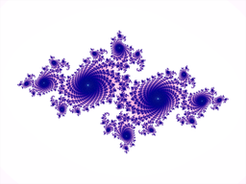
int Diameter = 30;
int W = 600,
H = 600;
int xC = 300,
yC = 300;
int dx = 3,
dy = 1;
PFont font;
color Yellow = color(255, 255, 0),
Green = color(0, 255, 0),
BG_C = Yellow;
void setup() {
size(W, H);
smooth();
fill(Green);
}
void draw() {
background(BG_C);
ellipse(xC, yC, Diameter, Diameter);
xC += dx;
yC += dy;
}
Processing gives us the ability to draw ellipses.
General coding point.
Note that indentations help show the structure of the code
OneCircle.pde
Suppose that we just wanted to deal with circles. A circle is a specialised ellipse.
No classes
03/02/15
Click Me

Slide 4
int Diameter = 30;
int W = 600,
H = 600;
int xC = 300,
yC = 300;
int dx = 3,
dy = 1;
PFont font;
color Yellow = color(255, 255, 0),
Green = color(0, 255, 0),
BG_C = Yellow;
void setup() {
size(W, H);
smooth();
fill(Green);
}
void draw() {
background(BG_C);
ellipse(xC, yC, Diameter, Diameter);
xC += dx;
yC += dy;
}
03/02/15

Slide 5
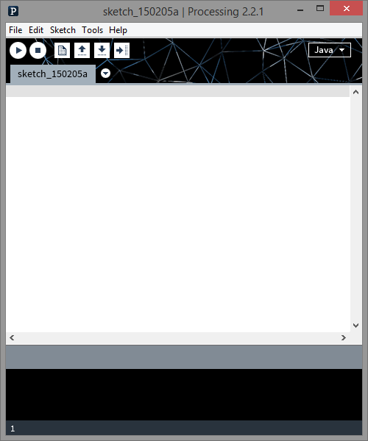
03/02/15

Slide 6
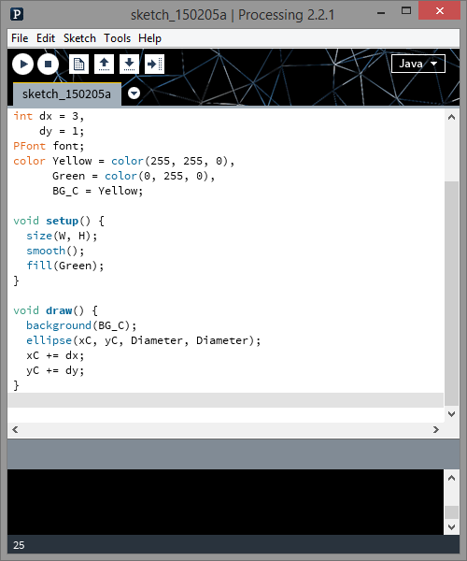
03/02/15

Slide 7
int Diameter = 30;
int W = 600,
H = 600;
int xC = 300,
yC = 300;
int dx = 3,
dy = 1;
PFont font;
color Yellow = color(255, 255, 0),
Green = color(0, 255, 0),
BG_C = Yellow;
void setup() {
size(W, H);
smooth();
fill(Green);
}
void draw() {
background(BG_C);
ellipse(xC, yC, Diameter, Diameter);
xC += dx;
yC += dy;
}
OneCircle.pde
Coordinates of centre of circle
Small movement in x and y direction each time draw() is called
No classes
Draw circle
Move circle
03/02/15

Slide 8
int D1 = 30,
D2 = 50;
int W = 600,
H = W;
int xC1 = 132,
yC1 = 178,
xC2 = 309,
yC2 = 77;
int dx1 = 3,
dy1 = 1,
dx2 = -1,
dy2 = 5;
PFont font;
color Yellow = color(255, 255, 0),
Red = color(255, 0, 0),
Green = color(0, 255, 0),
BG_C = Yellow;
void setup() {
size(W, H);
smooth();
}
void draw() {
background(BG_C);
fill(Green);
ellipse(xC1, yC1, D1, D1);
xC1 += dx1;
yC1 += dy1;
fill(Red);
ellipse(xC2, yC2, D2, D2);
xC2 += dx2;
yC2 += dy2;
}
Dealing with two moving circles this way involves duplication of code with different variable identifiers – e.g. xC1 and xC2
TwoCircles.pde
03/02/15
Click Me
No classes

Slide 9
int N = 4;
int[] Ds = {32, 76, 29, 10};
int W = 600,
H = W;
int[] xCs = {200, 450, 100, 50};
int[] yCs = {20, 350, 60, 40};
int[] dxs = {2, -1, 6, 0};
int[] dys = {5, 2, -1, 3};
color Yellow = color(255, 255, 0),
Red = color(255, 0, 0),
Green = color(0, 255, 0),
Blue = color(0, 0, 255),
BG_C = Yellow;
color[] Cols = {Red, Blue, Red, Green};
void setup() {
size(W, H);
smooth();
}
Of course we could keep a set of parallel arrays, each one for a different property of a circle. I’ve only indicated the colour attribute here so imagine the numeric data!
NotVeryGoodManyCircles
void draw() {
int i;
background(BG_C);
for(i = 0; i < N; i++) {
fill(Cols[i]);
ellipse(xCs[i], yCs[i], Ds[i], Ds[i]);
xCs[i] += dxs[i];
yCs[i] += dys[i];
}
}
No classes
03/02/15

Slide 10
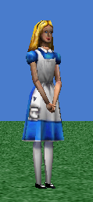
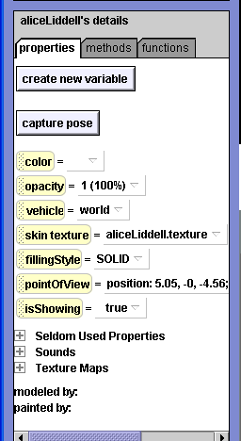
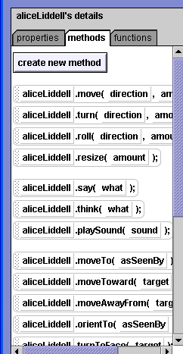
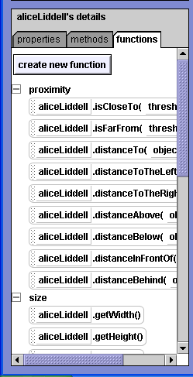
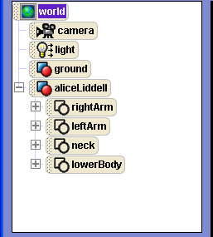
Alice Is In A Class Of Her Own!
Alice has a set of properties. Most properties, position, size etc. are changed by methods.
03/02/15

Slide 11
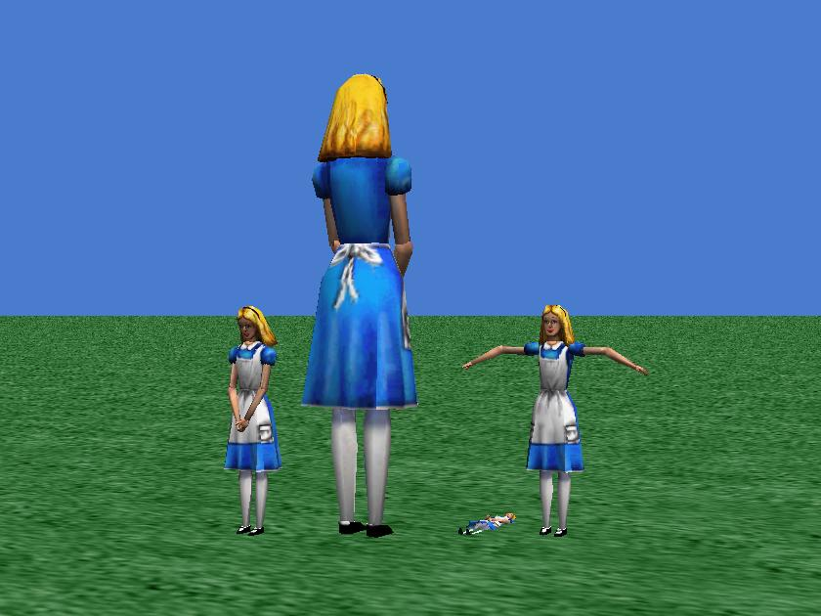
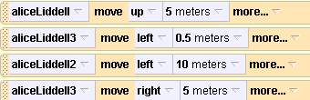
One set of Alice methods applies to any Alice object but the arguments the method uses from each object vary with the object.
Alice objects are all of the same class but each has its own attributes e.g. size, orientation etc.
03/02/15

Slide 12
class Circle {
int Cx,
Cy;
int dx,
dy;
int D;
color FillCol;
Circle(int Cx, int Cy, int D, color FillCol, int dx, int dy) {
this.Cx = Cx;
this.Cy = Cy;
this.dx = dx;
this.dy = dy;
this.D = D;
this.FillCol = FillCol;
}
void Draw() {
fill(FillCol);
ellipse(Cx, Cy, D, D);
}
void Move() {
Cx += dx;
Cy += dy;
}
}
Circle class
dx
FillCol
dy
D
(Cx, Cy)
I have written the code for the Circle class in Processing.
In Alice you didn’t see the code for an Alice object or a White Rabbit object, but the code for each class of object was already there in compiled Java bytecode.
03/02/15

Slide 13
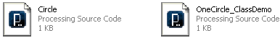
OneCircle_ClassDemo
int W = 600,
H = 600;
color Yellow = color(255, 255, 0),
Green = color(0, 255, 0),
BG_C = Yellow;
Circle C = new Circle(300, 300, 30, Green, 3, 1);
void setup() {
size(W, H);
smooth();
}
void draw() {
background(BG_C);
C.Draw();
C.Move();
}
OneCircle_ClassDemo
Move!
Messages
Circle
The OneCircle_ClassDemo main programme uses the class Circle, by creating one Circle object and passing messages to it about drawing itself and moving itself.
03/02/15

Slide 14
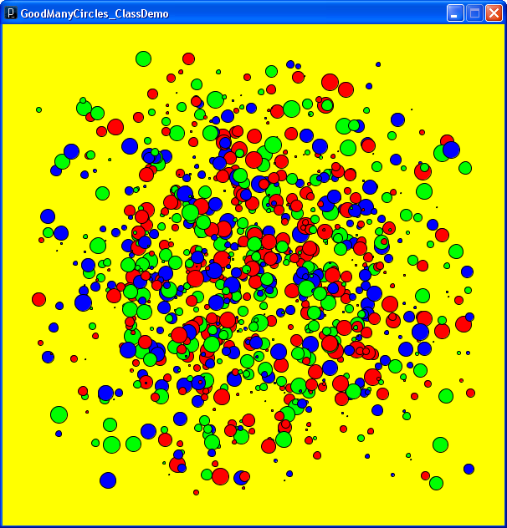
Alice objects are all of the same class or type but each has its own attributes.
Circle objects are all of the same class or type but each has its own attributes.
27/11/08
03/02/15

Slide 15
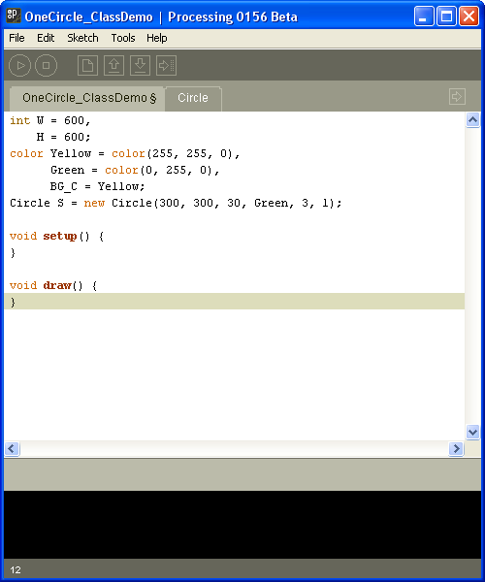
Building and using the Circle class (1)
Firstly we set up the values for size and colouring.
Then we set up method ‘skeletons’ for the two main Processing methods.
03/02/15

Slide 16
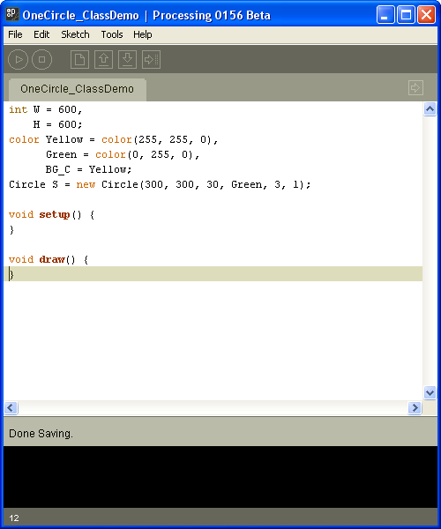
Click here because it is best to put the code for our new class in a separate tab
Building and using the Circle class (2)
03/02/15

Slide 17
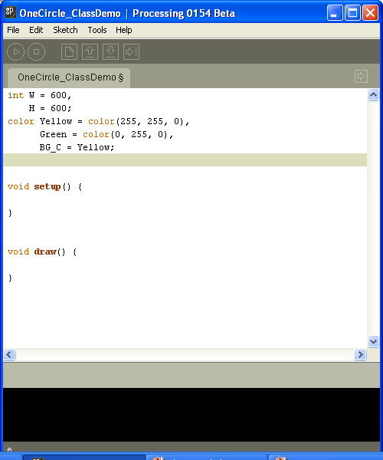
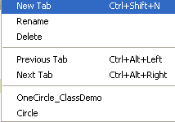
Choose New Tab
Building and using the Circle class (3)
03/02/15

Slide 18
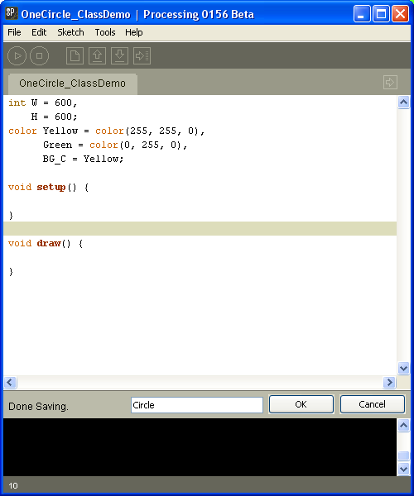
Building and using the Circle class (4)
We call it Circle, the same as the name of the class we want to build
Then click OK
03/02/15

Slide 19
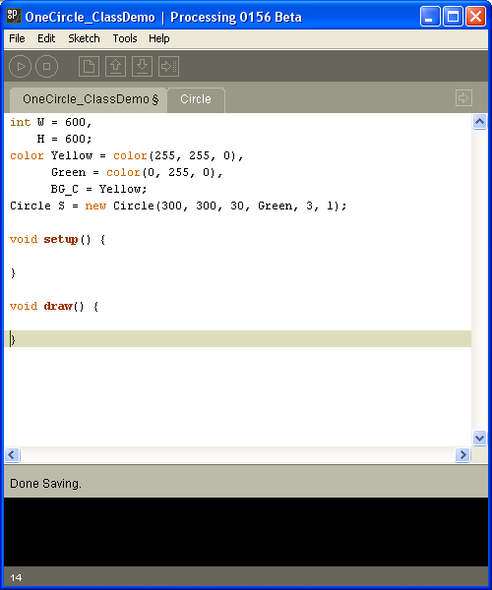
Building and using the Circle class (5)
Et voila! Now click on this tab
03/02/15

Slide 20
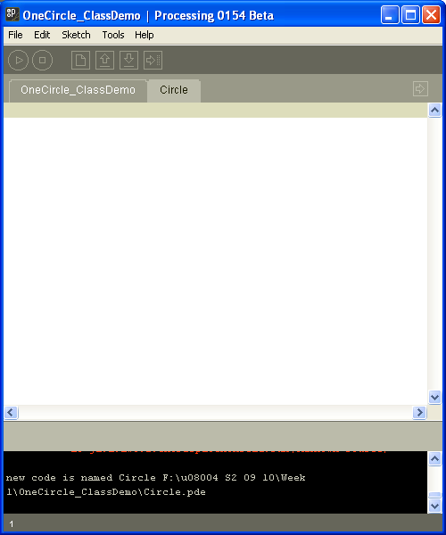
Building and using the Circle class (6)
Now we can start writing code for the Circle class itself
03/02/15

Slide 21
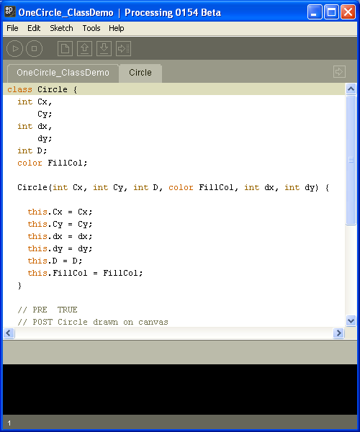
Building and using the Circle class (7)
Here’s the code
03/02/15

Slide 22
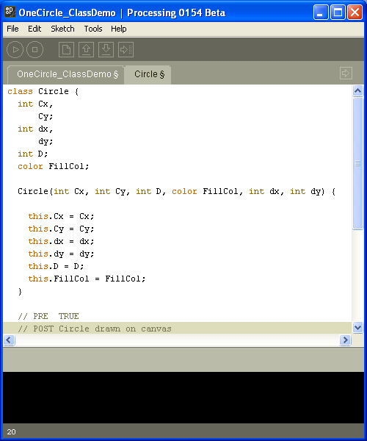
Building and using the Circle class (8)
Program Structure
OneCircle_ClassDemo
Circle
Classes
03/02/15

Slide 23
Building and using the Circle class (9)
Program Structure
OneCircle_ClassDemo
Circle
Classes
03/02/15

Slide 24
class Circle {
int Cx,
Cy;
……………………………………………
Circle(int Cx, int Cy, int D, color FillCol, int dx, int dy) {
this.Cx = Cx;
this.Cy = Cy;
…………………………………………………………….
}
// PRE TRUE
// POST Circle drawn on canvas
void Draw() {
fill(FillCol);
ellipse(Cx, Cy, D, D);
}
// PRE TRUE
// POST Moves this (dx, dy)
void Move() {
Cx += dx;
Cy += dy;
}
}
Start of class declaration
A special method, called a constructor, has the same name as the class and no return type.
Code initially run when the constructor is called to construct the new object (instance) of the class (type)
this.Cx means the Cx local variable of the object to distinguish it from the Cx passed in as a parameter
Each object of the class has access to the methods of the class but the values put in and returned, if any, apply only to that object.
03/02/15
End of class declaration
Classes

Slide 25


Abstraction
void draw() {
background(BG_C);
C.Draw();
C.Move();
}
OneCircle_ClassDemo
Up top in OneCircle_ClassDemo
Classes
Circle
draw
All the methods in OneCircle_ClassDemo know about is the names and parameters of the methods in Circle – they are not interested in the implementation of those methods. We can replace them with other methods of the same name, as long as they do the same job! What it does is abstracted away from how it does it!
Down below in
Circle
Move()
03/02/15
Move() is implemented using an elephant

Slide 26

Abstraction
void draw() {
background(BG_C);
C. Draw();
C. Move ();
}
OneCircle_ClassDemo
Classes
Up top in OneCircle_ClassDemo
Circle
draw
All the methods in OneCircle_ClassDemo know about is the names and parameters of the methods in Circle – they are not interested in the implementation of those methods. We can replace them with other methods of the same name, as long as they do the same job! What it does is abstracted away from how it does it!
Down below in the
Circle object
Move()
Move()
03/02/15
Move() is implemented using a Mad Hatter

Slide 27
void draw() {
int i;
background(BG_C);
for(i = 0; i < N; i++) {
Circles[i].Draw();
Circles[i].Move();
}
}
int W = 600,
H = 600;
color Yellow = color(255, 255, 0),
Green = color(0, 255, 0),
Red = color(255, 0, 0),
Blue = color(0, 0, 255),
BG_C = Yellow;
color[] Cols = {Red, Green, Blue};
int numCols = Cols.length;
int N = 1000;
Circle[] Circles = new Circle[N];
void setup() {
int i;
int MaxD = 20;
for(i = 0; i < N; i++) {
Circles[i] = new Circle(W/4 + int(random(W/2) + 0.5),
H/4 + int(random(H/2) + 0.5),
int(random(MaxD) + 0.5), Cols[int(random(numCols))],
2 - int(random(5)), 2 - int(random(5)));
}
size(W, H);
smooth();
}
GoodManyCircles_ClassDemo
As before.
Circle
An array of objects is much more sensible than parallel arrays of their attributes!
03/02/15

Slide 28
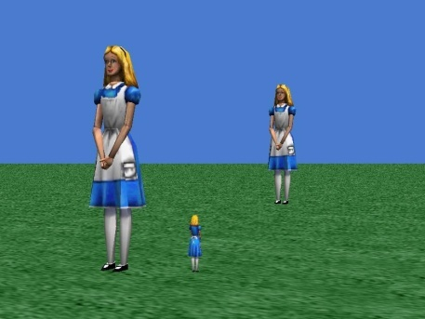
Summary Part 1
Whether we are talking of modelling real entities, e.g. bank accounts, students, towns etc., or of ‘fictional entities’, Alice characters, graphical shapes etc., we usually have to store a set of data for each entity and a set of operations for each sort of entity.
Object oriented programming is designed to let designers and programmers do this. Once we are happy with the idea, the design and implementation of programmes to sole real problems becomes much easier.
Object orientation allows us to separate ‘what it does’ from ‘how it does it’. This helps us firstly in design and then in updating programmes for efficiency by substituting a different implementation for the same abstract specification. This will become clearer in the practical and further weeks.
03/02/15

Slide 29
Classes and Objects in Processing Part 2
An object is a collection of data items and methods making up the state and behaviour of the object. In that sense it is (in part) a data structure. In other languages such as C and Pascal we have records. These are data structures like objects but with no behaviour, just data.
A very important issue is that of what goes where. It is really important to get clear what behaviour belongs in an object of a class, and which class, and what belongs in the main programe. The main programme is all the code that is not in a class
Another data structure we have seen before is an array. We have used arrays of integers and arrays of characters.
int[] MyNumbers = new int[10];
char Alphabet = new char[26];
27/11/08
03/02/15

Slide 30
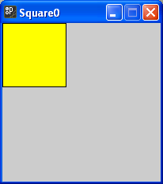
void setup() {
color Yellow = color(255, 255, 0);
size(200, 200);
Square S = new Square(40, 40, 40);
S.Col = Yellow;
S.Draw();
}
class Square {
int Cx,
Cy;
int HS;
color Col;
int dx,
dy;
Square(int Cx, int Cy, int HS) {
this.Cx = Cx;
this.Cy = Cy;
this.HS = HS;
}
void Draw() {
rectMode(CENTER);
fill(Col);
rect(Cx, Cy, HS * 2, HS * 2);
}
}
HS * 2
= 40 * 2
= 80
Main programme
Square0.pde
HS * 2
= 40 * 2
= 80
(40, 40)
HS is the name of the parameter for the ‘half side’ of the Square.
Code for class implementation.
From now on, until we change it using rectMode(CORNER), the rect() instruction uses its first two parameters to locate the centre of the rectangle, the last two being its width and height.
03/02/15

Slide 31
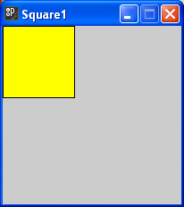
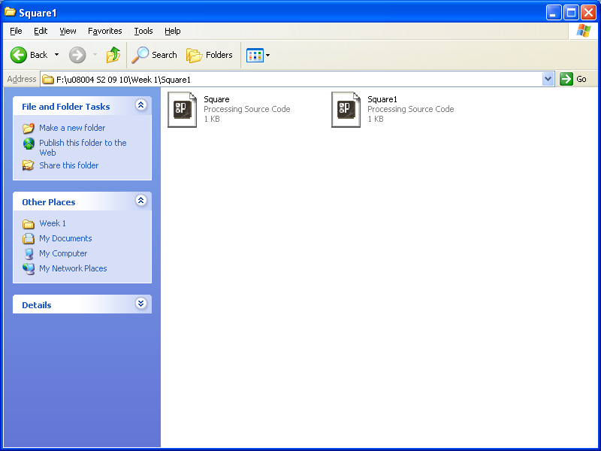
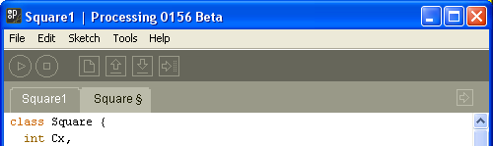
void setup() {
color Yellow = color(255, 255, 0);
size(200, 200);
Square S = new Square(40, 40, 40);
S.Col = Yellow;
S.Draw();
}
Square1.pde
class Square {
int Cx,
Cy;
int HS;
color Col;
int dx,
dy;
Square(int Cx, int Cy, int HS) {
this.Cx = Cx;
this.Cy = Cy;
this.HS = HS;
}
void Draw() {
rectMode(CENTER);
fill(Col);
rect(Cx, Cy, HS * 2, HS * 2);
}
}
Square.pde
Square1.pde
Using a separate tab for the Square class
Square.pde
03/02/15

Slide 32
class Square {
int Cx,
Cy;
int HS;
color Col;
int dx,
dy;
Square(int Cx, int Cy, int HS) {
this.Cx = Cx;
this.Cy = Cy;
this.HS = HS;
}
void Draw() {
rectMode(CENTER);
fill(Col);
rect(Cx, Cy, HS * 2, HS * 2);
}
void Move() {
Cx += dx;
Cy += dy;
}
}
Square.pde
Adding Animation – e.g. movement (1)
dx
dy
Moving Square
03/02/15

Slide 33

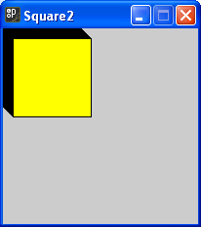
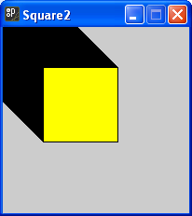
Square2.pde
Adding Animation – e.g. movement (2)
Square S = new Square(40, 40, 80);
void setup() {
color Yellow = color(255, 255, 0);
size(200, 200);
S.Col = Yellow;
S.Draw();
S.dx = 1;
S.dy = 1;
}
void draw() {
}
void mousePressed() {
S.Move();
S.Draw();
}
Square2.pde
Square.pde
But why the following shadow?
03/02/15

Slide 34
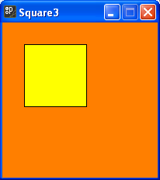
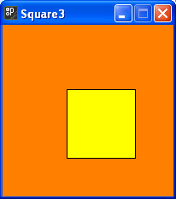
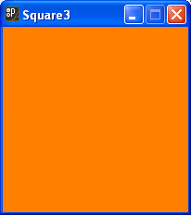
Square3.pde
Square S = new Square(40, 40, 80);
color Yellow = color(255, 255, 0),
Orange = color(255, 127, 0);
void setup() {
size(200, 200);
S.Col = Yellow;
S.dx = 1;
S.dy = 1;
}
void draw() {
background(Orange);
S.Draw();
S.Move();
}
background(..) ‘splashes paint’ all over the canvas. No more shadows!
Remember draw() is called 60 times per second so every 1/60th of a second orange is ‘splashed all over the canvas’, then the square is drawn and finally the values of the position of the square are changed in readiness for the next draw() call.
NOTE: No change to the code for the Square object, just to the main program that uses the Square object.
03/02/15

Slide 35
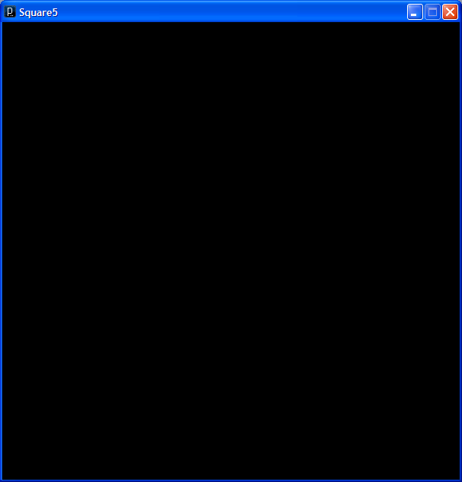
……………………….
void AdjustVelocity(Square S) {
int HS = S.Side/2;
if(S.Cx - HS < 0 || W < S.Cx + HS) {
S.dx = - S.dx;
}
if(S.Cy - HS < 0 || H < S.Cy + HS) {
S.dy = - S.dy;
}
}
void draw() {
background(Orange);
S.Draw();
AdjustVelocity(S);
S.Move();
}
Back you go!
Square4.pde
The main programme, here Square4, ‘knows’ where the edges of the canvas are and can get the position of the Square object. With a little bit of arithmetic on the coordinates of the Square’s centre and its size it can ‘work out’ when to tell it to reverse.
03/02/15
Click
Me

Slide 36
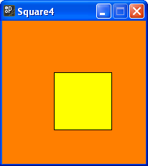
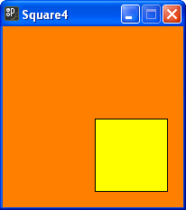
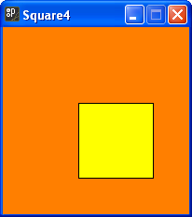
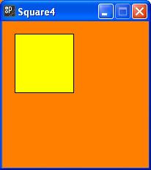
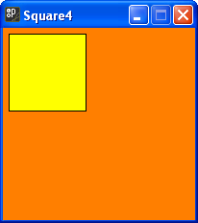
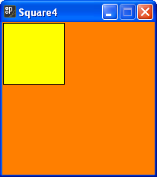
Square4.pde
03/02/15

Slide 37
color Yellow = color(255, 255, 0),
Orange = color(255, 127, 0);
int W = 600,
H = W;
int N = 1000;
Square[] Sqs = new Square[N];
As we have seen with Circles an array of objects is a perfectly good array. So we can have an array of Squares.
More General Point on Arrays of Objects
0
1
2
4
In fact it does not contain the objects but rather their addresses in memory. This is indicated by arrows to the memory location referred to or pointed at. In Java these addresses are known as references, and in C as pointers.
3
Sqs
Square5.pde
Cx | 12
Cy | 23
Side | 25
Col | Yellow
dx | 2
dy | -1
I have used this rather scary colour to indicate that the simple Square pointed to in this diagram actually has the more complex structure shown here. This is the object.
03/02/15

Slide 38
color Yellow = color(255, 255, 0),
Orange = color(255, 127, 0);
int W = 600,
H = W;
int N = 1000;
Square[] Sqs = new Square[N];
ManySquares.pde
Cx | 33
Cy | 109
Side | 30
Col | Green
dx | 2
dy | 0
0
1
2
3
4
Sqs
Cx | 12
Cy | 48
Side | 12
Col | Orange
dx | 0
dy | 3
Cx | 44
Cy | 66
Side | 10
Col | Red
dx | 2
dy | 1
Cx | 12
Cy | 280
Side | 224
Col | Blue
dx | -2
dy | 1
Cx | 12
Cy | 23
Side | 25
Col | Yellow
dx | 2
dy | -1
03/02/15

Slide 39
void setup() {
size(W, H);
int i;
int Cx,
Cy;
int MaxS = W/20;
int MaxSpeed = 5;
int Side;
int dx,
dy;
Square S;
for(i = 0; i < N; i++) {
Cx = W/2;
Cy = H/2;
Side = int(random(MaxS));
S = new Square(Cx, Cy, Side);
S.dx = int(random(MaxSpeed)) - MaxSpeed/2;
S.dy = int(random(MaxSpeed)) - MaxSpeed/2;
S.Col = color(random(256), random(256), random(256));
Sqs[i] = S;
}
}
0
1
2
3
4
Sqs
ManySquares.pde
Cx | 44
Cy | 66
Side | 10
Col | Red
dx | 2
dy | 1
Cx | 33
Cy | 109
Side | 30
Col | Green
dx | 2
dy | 0
03/02/15

Slide 40
void AdjustVelocity(Square S) {
int HS = S.Side/2;
if(S.Cx - HS < 0 || W < S.Cy + HS) {
S.dx = - S.dx;
}
if(S.Cy - HS < 0 || H < S.Cy + HS) {
S.dy = - S.dy;
}
}
void draw() {
Square S;
int i;
background(0);
for(i = 0; i < N; i++) {
S = Sqs[i];
S.Draw();
AdjustVelocity(S);
S.Move();
}
}
ManySquares.pde
03/02/15

Slide 41
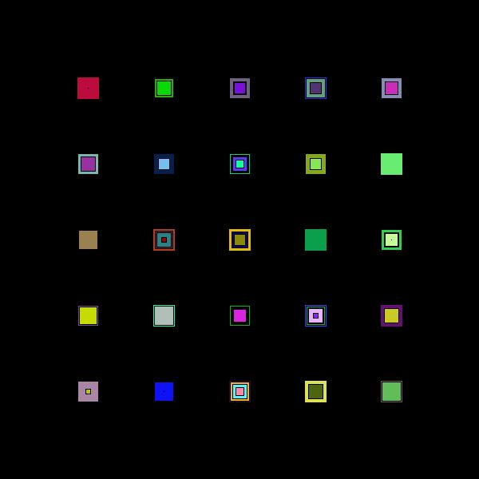
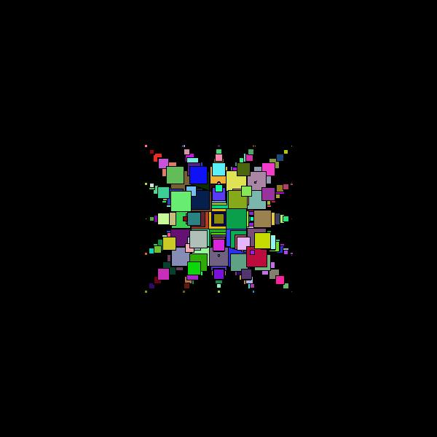
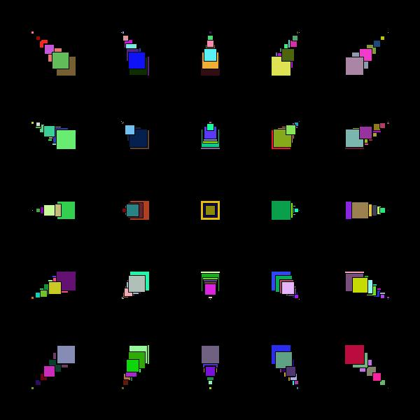
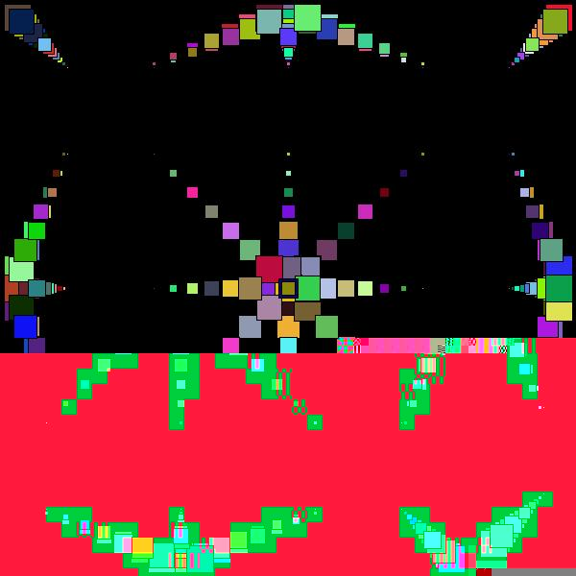
ManySquares.pde
Click
Me
03/02/15

Slide 42
Summary Part 2
We have now introduced another programmer defined class, that of Square.
If we have many objects of one type then we often find it useful to keep them in an array of objects. Previously we had arrays of integers or strings. Now we can have arrays of Alice objects or arrays of Circle or arrays of Square objects.
0
1
2
3
4
Sqs
Square5.pde
03/02/15

Slide 43
class Circle {
float Cx,
Cy;
float dx,
dy;
float R;
color FillCol;
Circle(int Cx, int Cy, int R, color FillCol) {
this.Cx = Cx;
this.Cy = Cy;
this.R = R;
this.FillCol = FillCol;
}
// PRE TRUE
// POST Circle drawn on canvas
void Draw() {
fill(FillCol);
ellipse(Cx, Cy, 2 * R, 2 * R);
}
void Move() {
Cx += dx;
Cy += dy;
}
boolean QMouseIn() {
return(sq(mouseX - Cx) + sq(mouseY - Cy) < sq(R));
}
}
Adventures with a Circle 1
03/02/15

Slide 44
int W = 600,
H = 600;
color Red = color(255, 0, 0),
Green = color(0, 255, 0);
int R = 20;
Circle C = new Circle(200, 300, R, Red);
void setup() {
size(W, H);
C.dx = -4.1;
C.dy = 4.2;
smooth();
}
void draw() {
background(Green);
C.Move();
if(C.Cx - R <= 0 || width < C.Cx + R) {
C.dx = - C.dx;
}
if(C.Cy - R <= 0 || height < C.Cy + R) {
C.dy = - C.dy;
}
C.Draw();
}
void mousePressed() {
if(C.QMouseIn()) {
C.dx = - C.dx;
C.dy = - C.dy;
}
}
Adventures with a Circle 2
DiscJump1
03/02/15
Click Me

Slide 45
………………………….
int R = 20;
Circle C = new Circle(200, 300, R, Red);
void setup() {
size(W, H);
C.dx = -4.1;
C.dy = 4.2;
smooth();
}
void draw() {
background(Green);
C.Move();
if(C.Cx - R <= 0 || width < C.Cx + R) {
C.dx = - C.dx;
}
if(C.Cy - R <= 0 || height < C.Cy + R) {
C.dy = - C.dy;
}
C.Draw();
}
void mousePressed() {
if(C.QMouseIn()) {
C.dx*=1.2;
C.dy*=1.01;
C.dx = - C.dx;
C.dy = - C.dy;
}
}
void keyPressed() {
C.dx = - C.dx;
C.dy = - C.dy;
}
Adventures with a Circle 3
DiscJump2
03/02/15
Click Me

Slide 46
void draw() {
background(Green);
C.Move();
if(C.Cx - R <= 0 || width < C.Cx + R) {
C.dx = - C.dx;
}
if(C.Cy - R <= 0 || height < C.Cy + R) {
C.dy = - C.dy;
}
C.Draw();
}
void mousePressed() {
if(C.QMouseIn()) {
C.dx*=1.2;
C.dy*=1.01;
C.dx = - C.dx;
C.dy = - C.dy;
}
}
void keyPressed() {
switch(key) {
case 'b':
C.dx = - C.dx;
C.dy = - C.dy;
break;
case '0':
C.dx = 0;
C.dy = 0;
break;
case 'r':
C.dx = random(6) - 3;
C.dy = random(6) - 3;
break;
}
}
Adventures with a Circle 4
DiscJump3
03/02/15

